Slide 1

Mozilla Projects

Slide 2

about:me
Gabriel Ivănică
Reprezentant Mozilla
JavaScript++
gabriel.ivanica@mozilla.ro

Slide 3
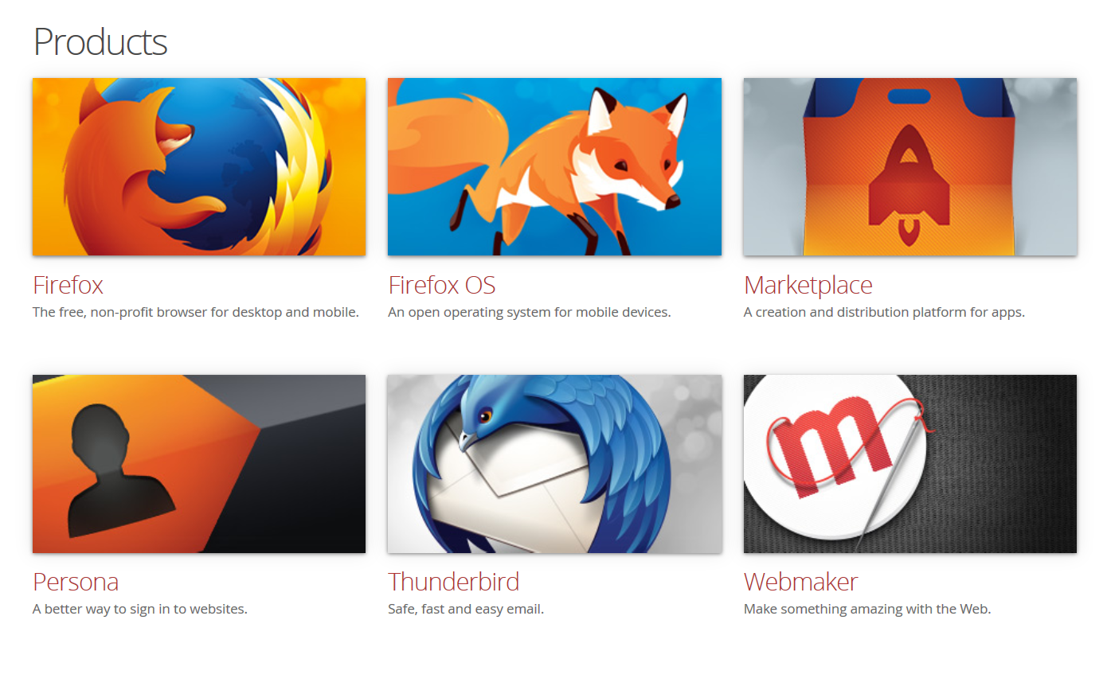

Slide 4
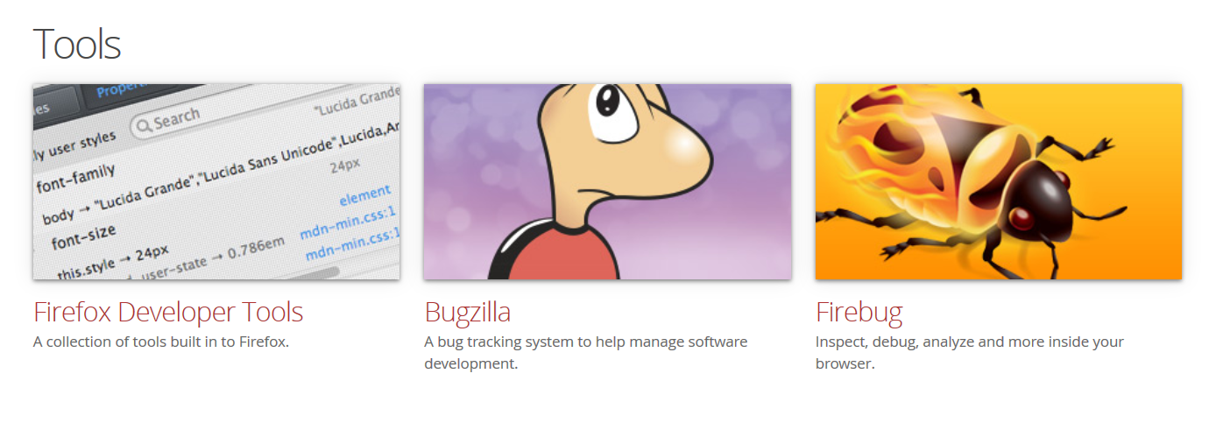
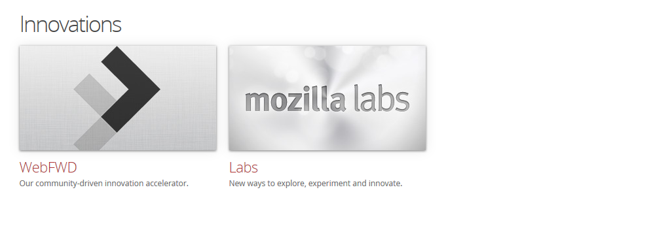

Slide 5










Get Involved
Helping Users
Quality Assurance
Coding
Spread the Word
Localization
Web Development
Add-ons
Visual Design
Documentation and Writing
Education

Slide 6

Ask not what Mozilla can do for you but what you can do for Mozilla
http://whatcanidoformozilla.org
Josh Matthews
https://github.com/jdm

Slide 7

Rust a safe, concurrent, practical language
http://www.rust-lang.org/
https://github.com/mozilla/rust

Slide 8
Type system | static, nominal, linear, algebraic, locally inferred
Memory safety | no null or dangling pointers, no buffer overflows
Concurrency | lightweight tasks with message passing, no shared memory
Generics | type parametrization with type classes
Exception handling | unrecoverable unwinding with task isolation
Memory model | optional task-local GC, safe pointer types with region analysis
Compilation model | ahead-of-time, C/C++ compatible
License | dual MIT / Apache 2

Slide 9
Servo
The Servo Parallel Browser Project
prototype web browser engine written in the Rust
developed on 64bit OS X and 64bit Linux
https://github.com/mozilla/servo

Slide 10

An LLVM-to-JavaScript Compiler
https://github.com/kripken/emscripten

Slide 11

Flash VM and runtime written in JavaScript
https://github.com/mozilla/shumway

Slide 12
Mozilla Research
LLJS
C-like type system with manual memory management
broadway.js
pure JavaScript and HTML decoder of the H.264
Parallel JavaScript
asm.js

Slide 13

Efficient Portable Document Format (PDF) renderer without native code assistance
https://github.com/mozilla/pdf.js

Slide 14

Mozilla Popcorn supercharges web video
https://github.com/mozilla/popcorn-js

Slide 15

TogetherJS is a service for your website that makes it easy to collaborate in real-time
https://github.com/mozilla/togetherjs

Slide 16
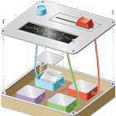



Mozilla Labs
Meemoo
Open Badges
Persona
Prospector

Slide 17

Community Engagement

Slide 18

Represent Mozilla in their country/region
Promote the Mozilla Project and our mission
Build on and support existing/future local community efforts and programs
Inspire, recruit and support new contributors
Support and mentor future Mozilla Reps
Document clearly all his/her activities

Slide 19

Promote Firefox
Support the successful launch of Firefox OS in communities (and campuses!) around the world
Educate others about Mozilla's mission
Grow the Mozilla Community

Slide 20
Community Engagement
Opportunity to:
learn new skills
earn recognition
advance leadership in the Mozilla community

Slide 21

We teach the web
We're a global community dedicated to teaching digital skills and web literacy. We explore, tinker and create together to build a web that's open and made by everyone.

Slide 22



Mozilla Webmaker
Thimble
Popcorn
X-Ray Goggles

